Slide 1
Assessing the utility of synthetic data: A density ratio perspective
Thom Benjamin Volker, Peter-Paul de Wolf & Erik-Jan van Kesteren
UNECE Expert Meeting on Statistical
Data Confidentiality

Slide 2
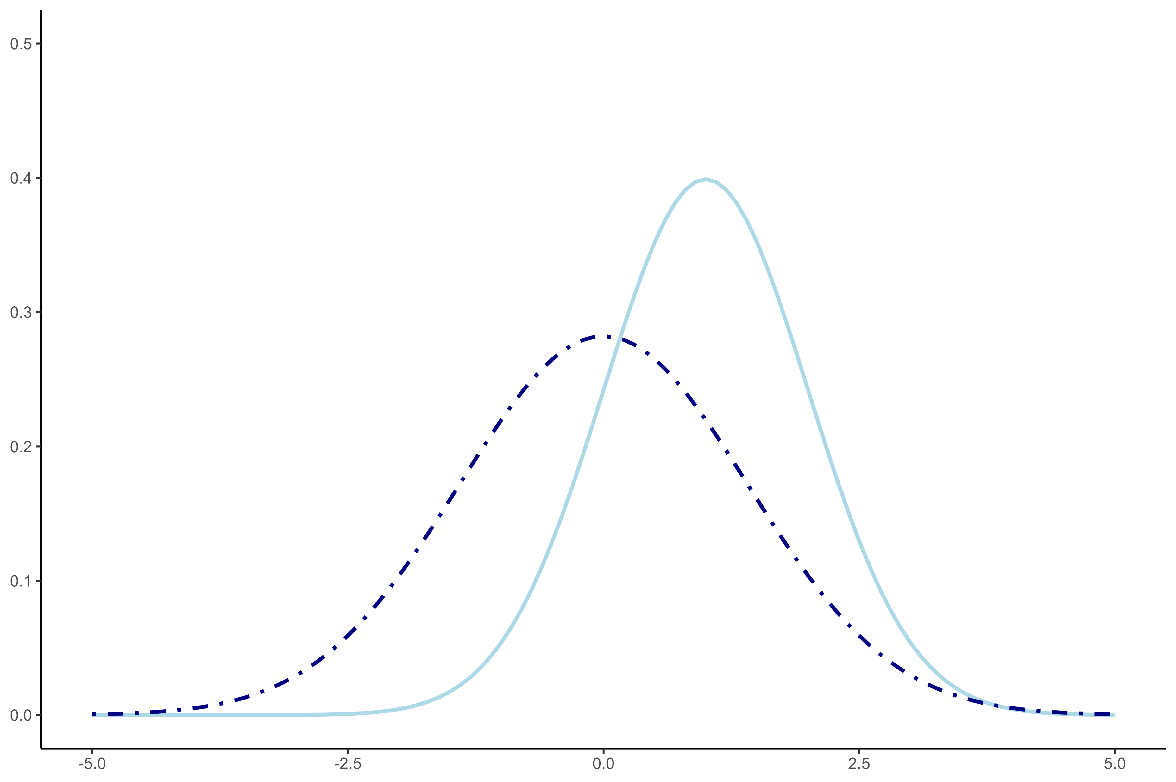
Synthetic data utility
Intuitively
How different are the synthetic data from the observed data?
Is the synthetic data (almost) as useful as the observed data?
Practically
Can we tell the observed and synthetic data apart?
Can we obtain inferences from the synthetic data that are similar to inferences from the observed data?

Slide 3
Utility is hard to measure
The utility of synthetic data depends on what it’s used for
How can we know what the synthetic data will be used for?
We can’t…
We need good measures for general utility (distributional similarity)
If the observed and synthetic data have indistinguishable distributions, they should allow for similar inferences.

Slide 4
Existing general utility measures
pMSE
Practical, easy to use
Not straightforward to specify the propensity score model
Increasingly difficult to use when the dimensionality of the data increases relative to the sample size
Kullback-Leibler divergence
Theoretically very elegant
Hard to estimate in practice
Notes:
Explain drawbacks of these methods: pMSE – very useful in practice, but how to specify a good model, especially when the dimensionality of the data increases?
KL divergence – theoretically very elegant, but hard to use/calculate in practice

Slide 5

Utility as a density ratio
$$r\left(x\right)=\frac{p_{syn}(x)}{p_{obs}(x)}$$

Slide 6
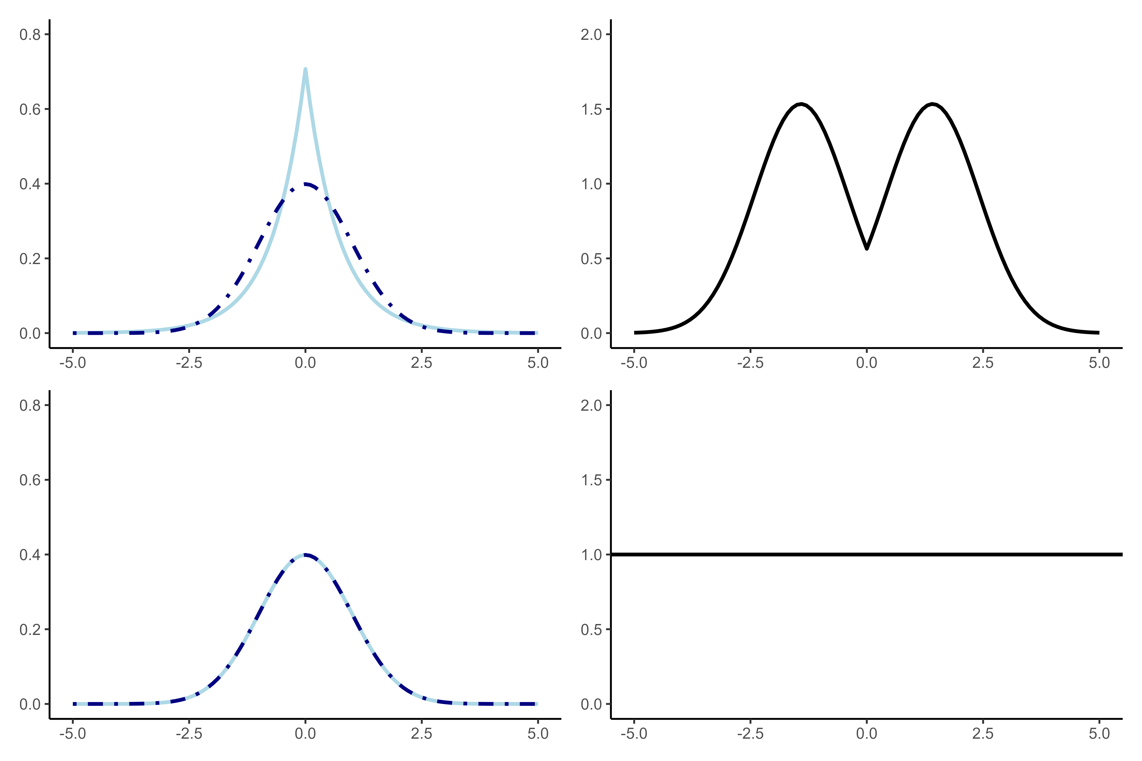
Evaluating utility: density ratios

Slide 7
Example: Density ratios for utility
Data – U.S. Current Population Survey (n = 5000)*
Four continuous variables (age, income, social security payments, household income)
Four categorical variables (sex, race, marital status, educational attainment)
Synthesis strategies
Linear models; transformations; semi-continuous + transformations; smoothed CART
Logistic / multinomial regression
* Our gratitude goes out to Jörg Drechsler for his willingness to share the data and synthesis script

Slide 8
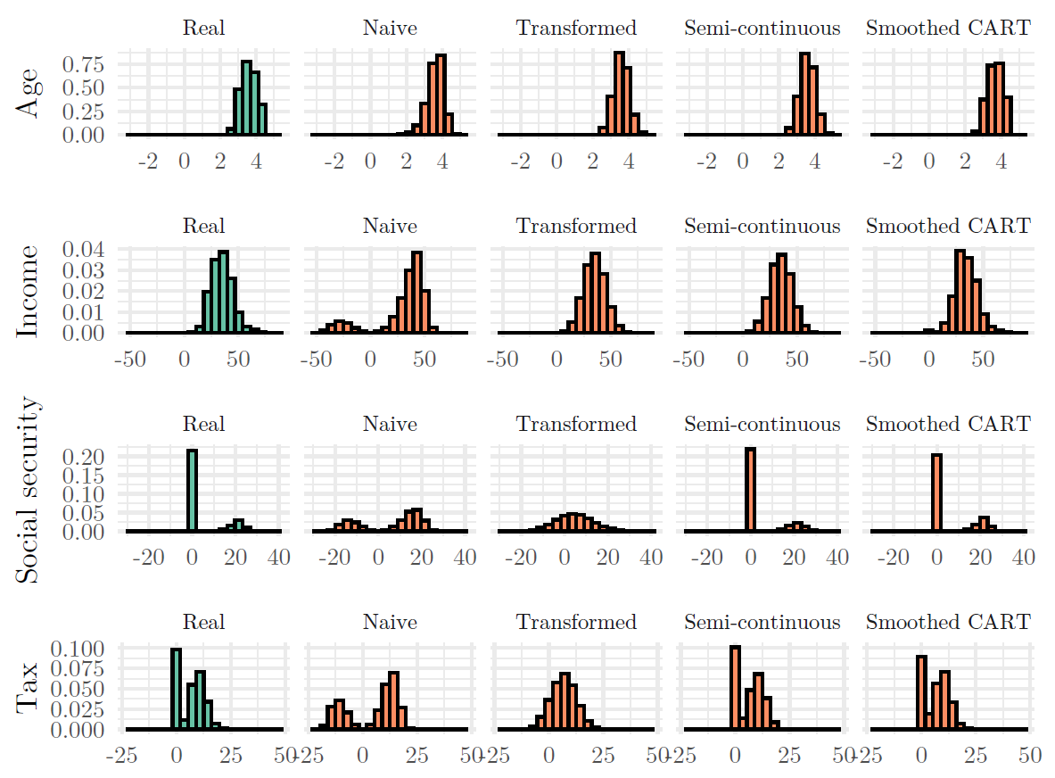

Slide 9
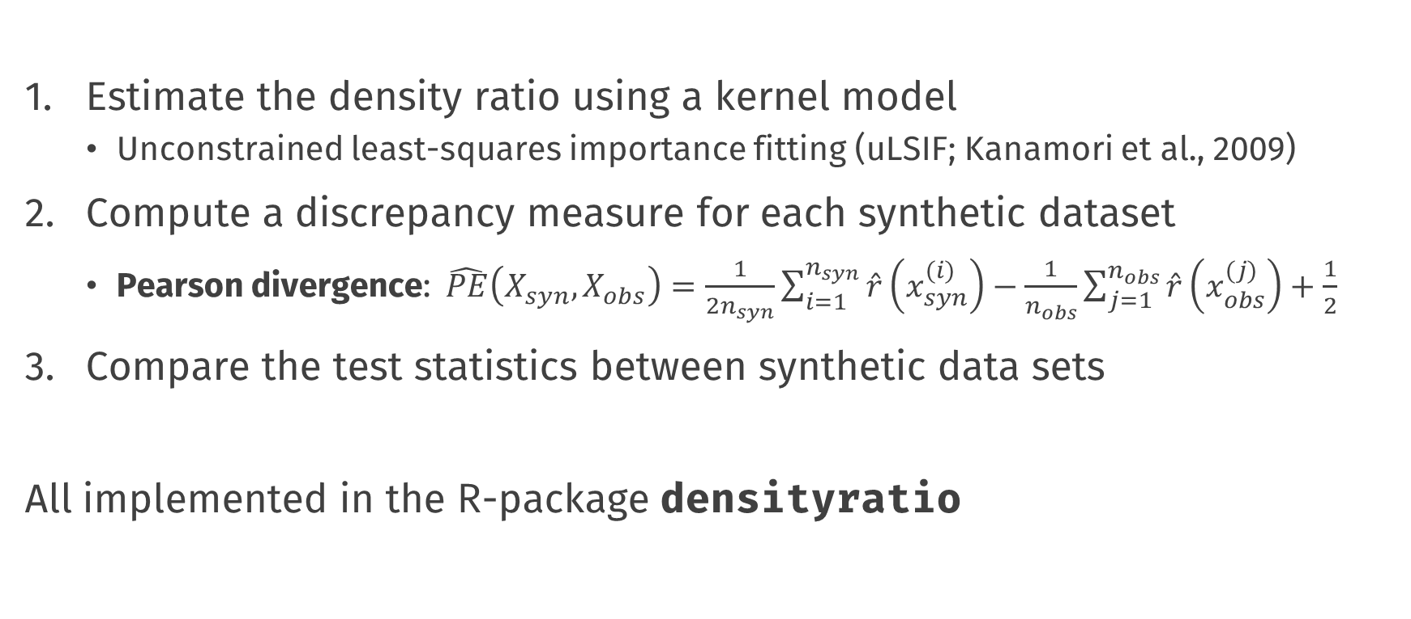
Assessing utility
Estimate the density ratio using a kernel model
Unconstrained least-squares importance fitting (uLSIF; Kanamori et al., 2009)
Compute a discrepancy measure for each synthetic dataset
Pearson divergence: $\hat{PE}\left(X_{syn}, X_{obs}\right)=\frac{1}{2n_{syn}}\sum_{i=1}^{n_{syn}}{\hat{r}\left(x_{syn}^{(i)}\right)−\frac{1}{n_{obs}}\sum_{j=1}^{n_{obs}}{\hat{r}\left(x_{obs}^{(j)}\right)+\frac{1}{2}}}$
Compare the test statistics between synthetic data sets
All implemented in the R-package densityratio

Slide 10
Assessing utility in R
library(densityratio)
# for every variable in every synthetic dataset, do:
dr <- ulsif(cps_synthetic$var, cps_real$var)
summary(dr_var)
# and for every entire synthetic dataset, do:
dr <- ulsif(cps_synthetic, cps_real)
summary(dr)

Slide 11
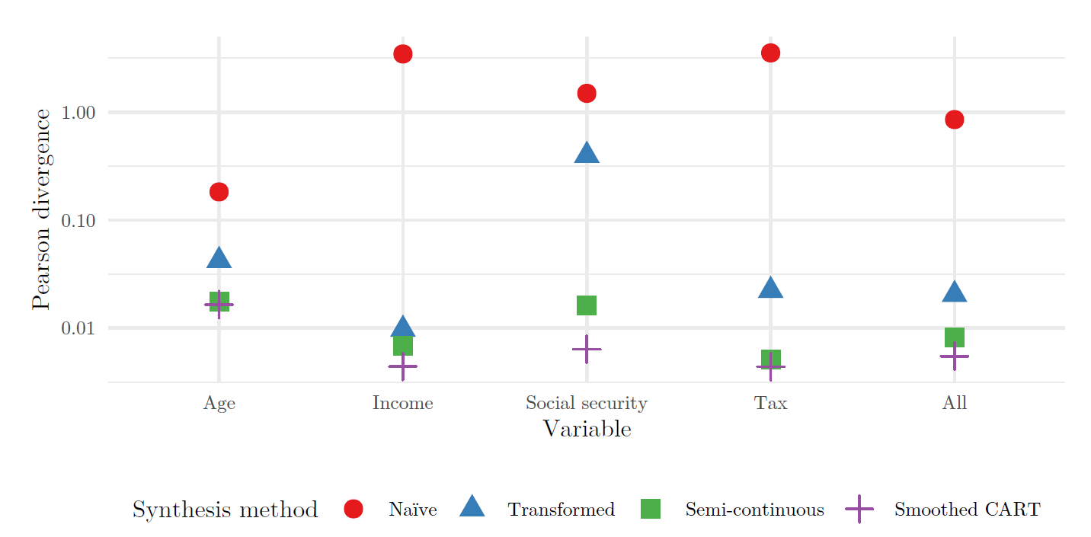

Slide 12
The way forward…
Density ratio estimation provides:
An intuitive framework for the evaluation of synthetic data;
Cross-validation for automatic hyperparameter selection;
Readily available extensions to high dimensional settings;
Utility scores for individual data points
But requires research into
How to deal with categorical data;
How to make best use of side products (e.g., individual utility scores)

Slide 13
Utility and privacy are opposites

Slide 14
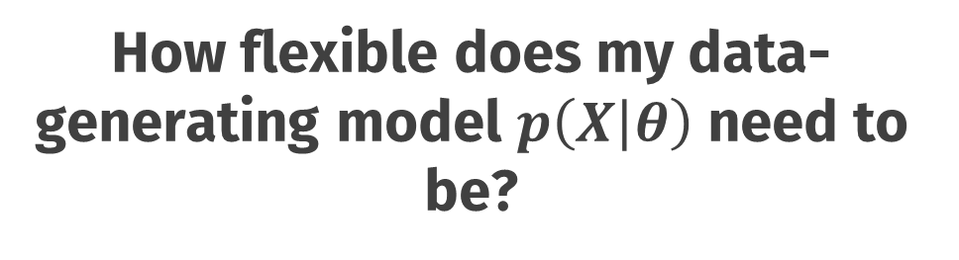
How flexible does my data-generating model $p\left(X | θ\right)$ need to be?
flexible
inflexible
Utility
Privacy

Slide 15
Conclusions

Slide 16
Default light slide
Default subheading
This is the body of the text
Default subheading
Note that the text is not black, but “black, text 1, lighter 25%”
Default subheading
This makes things easier on the eyes
Default subheading
This is the body of the text

Slide 17
Is this an impact slide?

Slide 18
Default light slide
This is the body of the text

Slide 19
Default dark slide
Default subheading
The dark slide brings some variation
Default subheading
It can highlight important aspects of the presentation.
Default subheading
This is the body of the text
Default subheading
This is the body of the text

Slide 20
Is this an impact slide?

Slide 21
Here is an impactful slide with a sentence on it.
Here is a topic related to the aforementioned question.

